Slide 1


Presented By: Rejey Ezekiel (2348935)
Air Quality and its Effects
ST1510 Programming for Data Analytics

Slide 2

Problem Statement
To what extent does air quality in Singapore impact public health, and how can we identify correlations between air quality parameters and health indicators?

Slide 3

Datasets
Air pollutant, Particulate Matter (DF1) (data.gov.sg)
Top 10 Health Conditions of Hospitalization (DF2) (data.gov.sg)
Principal of Death (DF3) (data.gov.sg)
Total Number of Deaths (DF4) (data.gov.sg)

Slide 4


Exploratory Data Analysis

Slide 5
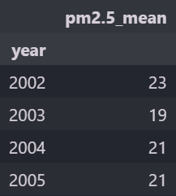
Air pollutant, Particulate Matter (DF1)
Key Details About the dataset:
It has 2 columns of data (year and pm2.5_mean)
Year states the year the data was taken on.
pm2.5_mean states the average Particulate Matter in the corresponding year.

Slide 6
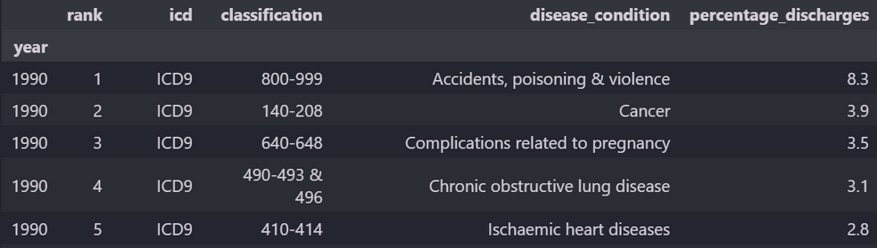
Top 10 Health Conditions of Hospitalization (DF2)
Key Details About the dataset:
It has 6 columns of data (year, rank, diease_condition, percentage_discharge)
Year states the year the data was taken on.
Rank is the ranking of the Top 10 Health conditions of hospitilisations.
ICD and Classification is a standardization for government's data tracking.
diease_condition is the different types of dieases in the dataset.
Lastly percentage_discharge is the discharge rate of patients with said diease condition

Slide 7
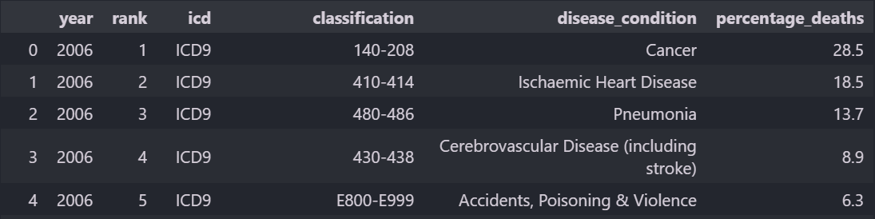
Principal of Death (DF3)
Key Details About the dataset:
Principal of Death dataset is very similar to the previous dataset where its only difference being the last column, percentage_deaths.
percentage of death shows the percentage of people who have died that year from whatever disease condition.

Slide 8
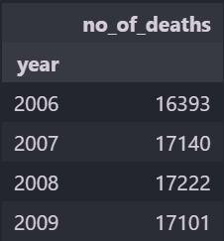
Total Number of Deaths (DF4)
Key Details About the dataset:
It has 2 columns of data (year and no_of_deaths)
Year states the year the data was taken on.
no of death shows the number of patients that have died in that year.

Slide 9
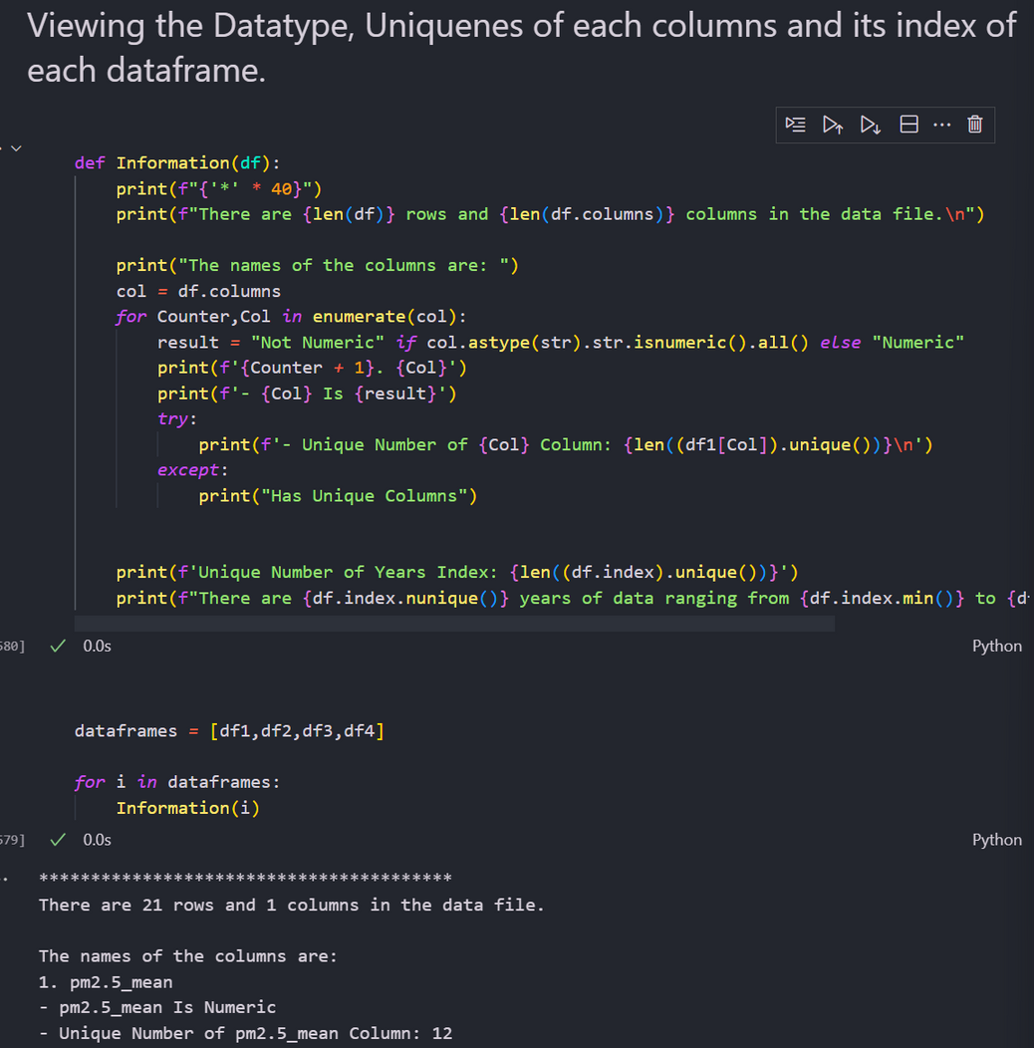
Data Wrangling
01. Before Performing any data Wrangling it is important to know what the dataset and some key information.
02. I have create a Function here in python to do so, This function takes in array of dataframes and prints out details like the columns, unique Values and whether its numeric or not.

Slide 10

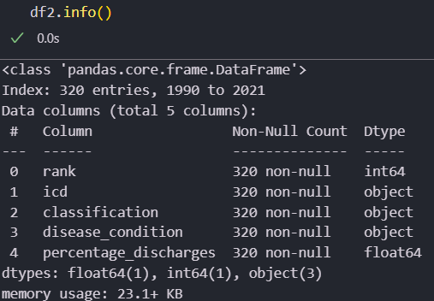

Dataset Information
Its Always important to also understand the datasets information as not all data can and will be a integer or float.
Therefore using .info in pandas allows us a quick way to view the datatypes used in the dataset.

Slide 11

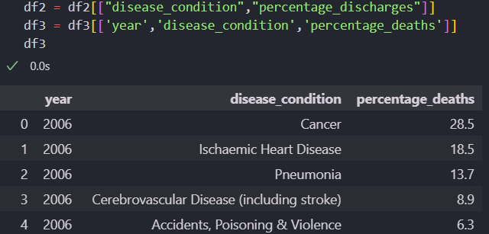

Cleaning the dataset
Since my datasets DF2 and DF3 has many unnecessary Columns Like Rank, ICD and Classification i will need to clean the dataset to only have important details.

Slide 12

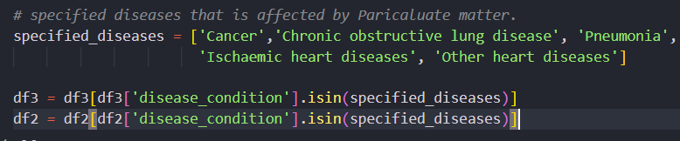

Cleaning the dataset Pt 2
The WHO has said that Breathing in Particulate Matter can cause Cancer, Chronic obstructive lung disease, Pneumonia, Ischemic heart diseases, Other heart diseases. since that is the case i will only be using rows with these diseases.

Slide 13

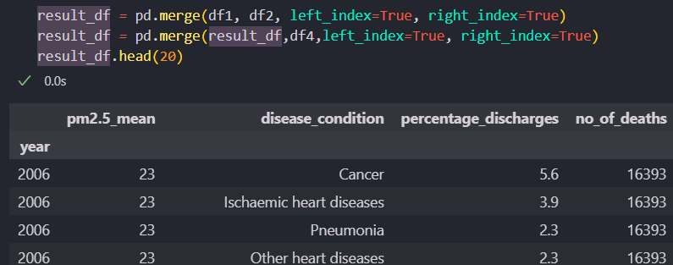
Merging the Datasets Together
I have merged together the Datasets Air pollutant, Particulate Matter (1) , Top 10 Health Conditions of Hospitalization (2) and Total Number of Deaths (4) together to easly see the data.
I have used merge over concat and pivot as the datasets below all follow the same index, being year this merging the dataset by year is more efficient

Slide 14
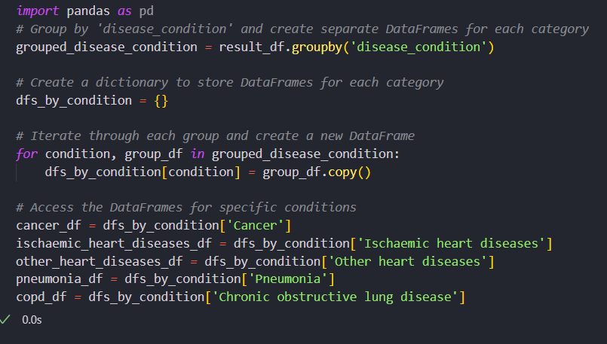
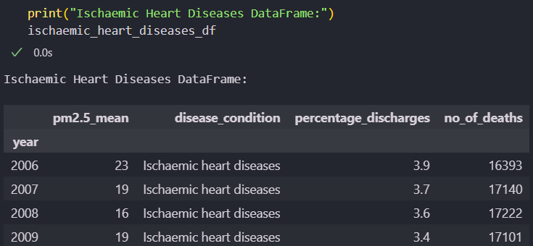
Data Transformation
Since our focus for the the merged dataset is the 5 Different Disease Conditions, I have made them separate Dataframes so that we can identify particular things withing each Diseases Condition.
Now we can easily plot and view the effects of particulate matter in each Diseases Condition.

Slide 15


Graphing

Slide 16
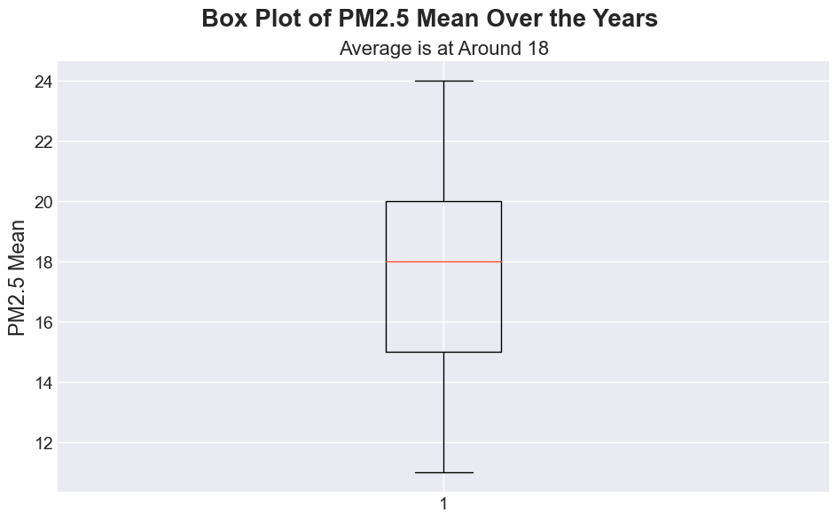
Viewing Distribution of Particulate Matter
Viewing Distributions can give us key insights and information about the dataset, to see whether its skewed and to check for outliers.
Particulate matter, especially PM2.5 (particles with a diameter of 2.5 micrometers or smaller), can penetrate deep into the respiratory system. So knowing its Highest Size and lowest size can be helpful.

Slide 17
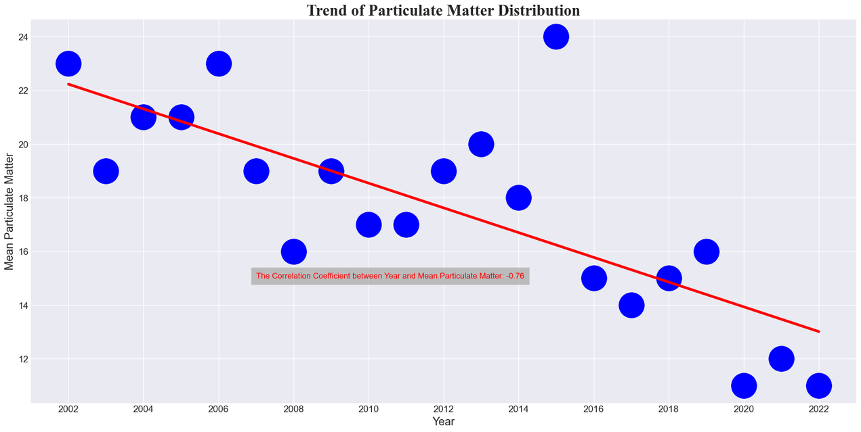
Trend of Particulate Matter
Knowing the trend of particulate matter is very important as it allows us to make Health Impact Assessment as Long-term exposure to high levels of PM causes various respiratory and cardiovascular diseases.
From the trend below it also shows that the Mean particulate matter is dropping over the years being a good sign for us

Slide 18
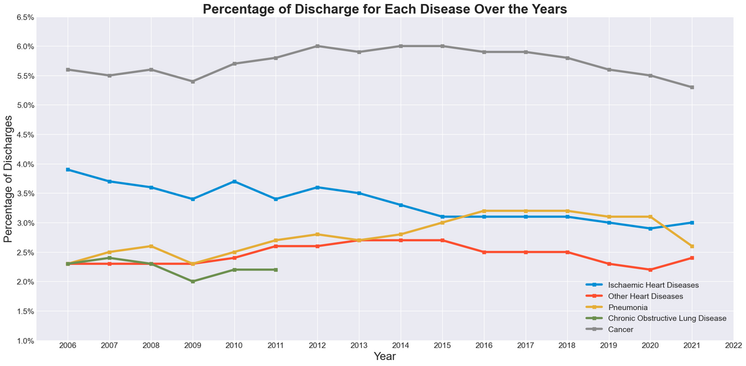
Distribution of Discharge for each Disease over the years
It is good to know distribution of the 5 key diseases as it helps in understanding the patterns and trends of diseases within a Singapore.
From the trend below we can see that the Percentage of Discharge for each disease has been around the same over the years.

Slide 19
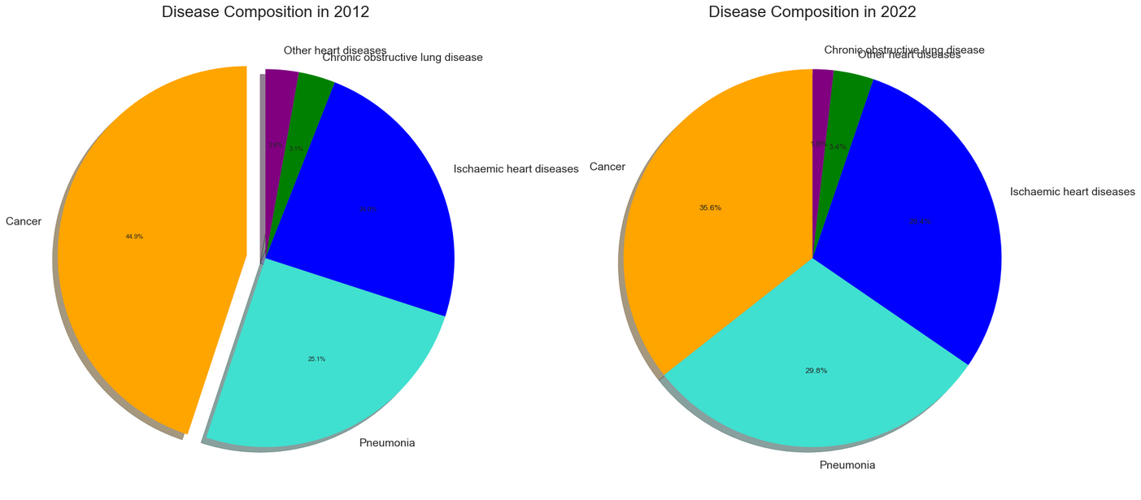
Distribution of the Dataset Diseases
Now we are seeing the distribution of the Diseases Composition in 2012 and 2022.
this shows valuable information that cancer is no longer as prevalent in 2022 and ischaemic heart diseases is now more prevalent then before

Slide 20
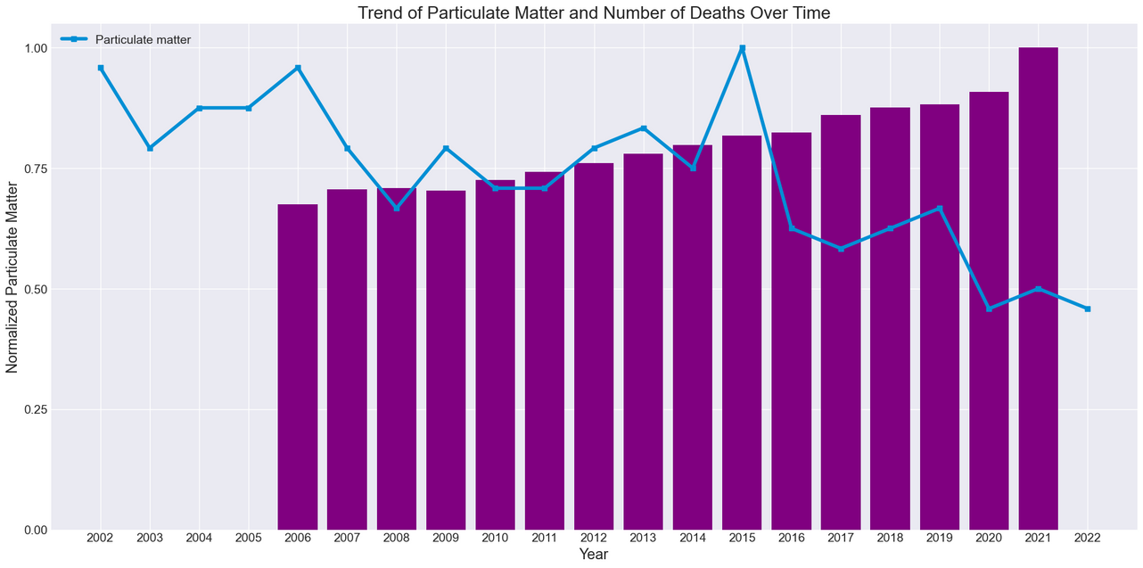
Trend in particulate matter and deaths over the Years
Firstly since this 2 Datasets are not normal and are of different values before plotting it i have normalized both the dataset as its easier to compare and analyze their relationships.
but here we can see that as particulate matter decreases Death per year increases, even though there seem to be a good relationships here it can be other factors affecting it.

Slide 21
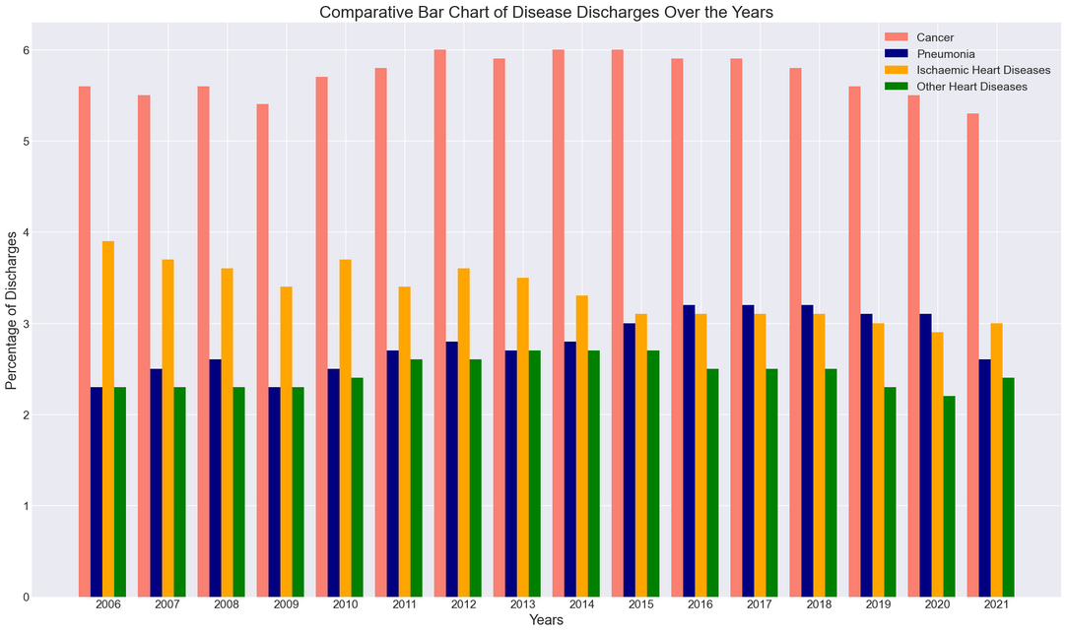
Comparative Diseases Discharge over the Years
This bar chart shows that over the years Cancer has the highest Discahrges if all the selected Diease
We can also see that Ischaemic Heart Dieases has reduced percentages overtime
These can be vital information

Slide 22
Conclusion
In conclusion i have understood that particulate matter may be a cause in different adverse health conditions not limited to the 5 i have presented, but nonetheless a serious matter at hand, from the charts we cannot confirm nor deny that particulate matter directly affects Singaporeans health. But we can confirm it plays a role in it.

Slide 23

Presented by Rejey Ezekiel
Thank you very much!

